Slide 1
Ending loneliness in the lives of seniors, one senior at a time!
Volunteer Training
Part 3 – Sensitivity

Slide 2
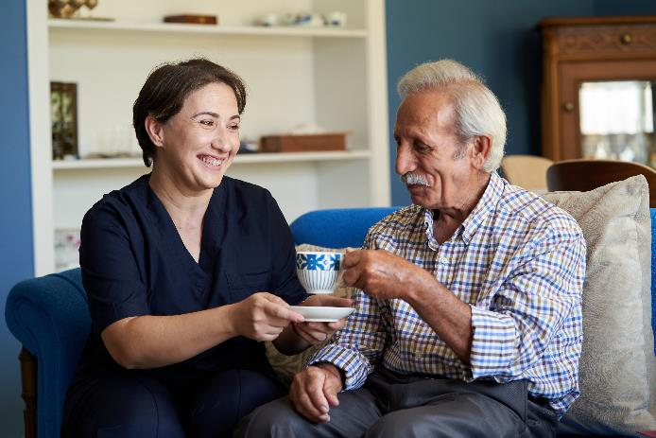
7 of 10 seniors never have a visitor.
What is Sensitivity?
Understand your Friend’s situation & what they are feeling – recognizing that you can’t feel exactly as they do. Your care & concern will help them cope.
Keep in mind that your Friend may have physical limitations that aren’t obvious, such as lack of tolerance to fluctuations in temperature.
Treat your Friend as an equal – the way you’d treat any other friend.
Understand the power that your own personal emotional state has on your Friend.
Remember – show empathy, not sympathy.
Notes:
Sensitivity is all of these things. Try to exhibit these behaviors in all your visits.
Your Friend may have physical limitations not limited to sight, vision, endurance and tolerance to fluctuations in temperature.
Treat your friend as an equal, the way you would treat any other friend.
Understand the power of your personal emotional state on the resident.
Empathize, not pity.
Try to understand your friend’s situation and what they are feeling, recognizing that you cannot feel exactly as they do. Your care and concern will help them cope.

Slide 3
7 of 10 seniors never have a visitor.
What’s it like to be old? Just imagine…
holding a bag of ice – that’s like sensitivity to cold.
sitting on a book – that’s like joint pain due to a lack of padding.
10 pebbles are in your shoes while you stand – that’s like neuropathic, painful walking.
you’re in a runaway wheelchair – that’s terrifying when you can’t stop yourself.
trying to clip papers together while wearing oven mitts – that’s like arthritis and loss of dexterity.
trying to read while wearing glasses with Vaseline on the lenses – that’s vision loss.
trying to read a document written in a language you don’t know – that’s like cognitive decline.
Trying to understand what someone is saying while wearing ear plugs – that’s like hearing loss.
Notes:
What some elderly people feel, but not all but some have one or two of the following, some have all and some have none. There are 90-year-olds running marathons and there are 90 year olds running companies. But the majority of those we are visiting are in care communities because one of the following ailments have made it unsafe for them to live independently.
When we could meet in person I would run my volunteers through these drills to increase their sensitivity and awareness to some of the physical changes those they are visiting might have.
I would give each volunteer a different experience. At the beginning of the talk about Sensitivity and understanding what it can mean to be elderly…
Sensitivity to Cold. one volunteer to hold a frozen water bottle or a bag of ice Simulates thermoregulation challenges of elders.
Joint pain lack of padding: One Volunteer would be asked to place a hardback book or board if we have one on their chair and sit on it. This is to bring attention to simulate painful seating options that should be avoided.
Mobility/Pain One volunteer or two will put 10 pebbles or unpropped popcorn it their shoes and stand for 10 minutes. This can simulate neuropathy and generally painful walking in some elders.
Accessibility and wheel chair safety: One Volunteer would sit in a borrowed wheelchair from the community and then navigate around the room… Another volunteer would be the driver/ pusher- … simulating situational awareness and accessibility issues for people in chairs. I would tell a story, a true story of one of our volunteers who was walking down the street pushing her senior’s wheelchair and the plastic handles came off in her hands and since they were on a slope she had to run to try to catch up with her senior careening down the sidewalk towards and intersection. All ended well. But we discuss caution on ramps and making sure wheel locks are properly engaged when your senior is seated.
Loss of Dexterity One or two volunteers would dawn Ski Gloves or oven mitts and try to put paper clips on paper. Simulation of arthritis and loss of dexterity of fingers in some elders.
Vision Loss: Volunteers would put on Dollar store glasses with Vaseline on the lenses and try to read. Simulating vision loss.
Cognitive Decline: One bilingual volunteer would write a phrase on a piece of paper and share with another that does not speak the language and ask them to read it and what it means. This is to simulate a person with cognitive decline . They can see the words sometimes but can’t understand.
Hearing One volunteer would wear earmuffs or ear plugs – simulation of hearing loss. Also, I would mention that when you speak to your senior you should do so in a lower octave if you, like me, have a higher voice. Hearing loss to high pitches is common in elders.
Speaking ** Also, when speaking with your senior speak clearly, slowly, but not in a condescending way. It is ok to ask your senior if they can hear you well enough and adjust from there.
**Do not stand over your senior when they are seated and talk down to them.. pull up a chair or get down on their level. When speaking with your friend you should always be talking to them, heart to heart, not down to them. This gives them the respect they deserve.
To make an example of this I would stand over a seated volunteer and hover in their personal space.
Hand shakes…. I would go around the room and ask volunteers to shake my hand… Showing them how to properly shake a senior’s hand… Meeting pressure and not squeezing their hands to avoid injury.

Slide 4
7 of 10 seniors never have a visitor.
How can I be more sensitive?
Introduce yourself each time you visit – your Friend may experience memory lapses or have trouble recalling your name.
Greet your Friend with a gentle handshake – grabbing or squeezing too tightly can cause pain for arthritis sufferers or those with a crippled hand. Don’t exceed their grip pressure.
Be observant – comment upon changes you see in your Friend’s surroundings.
Give genuine compliments whenever possible.
Remember your Friend on special days with cards, notes of friendship, and postcards – this brings them so much joy!
Notes:
Often lapses of memory and time between visits make it difficult to recall your name. If this is the case, introduce yourself each time you visit.
Greet your friend with a handshake yet do so yet gently. Grabbing or squeezing too tightly can be painful for arthritis sufferers or those who have crippled hands. A good rule of thumb is to meet but not exceed their grip pressure.
Observe and comment upon changes in the surroundings. Give genuine compliments whenever possible.
If you like, remember anniversaries, birthdays, and holidays with cards. An occasional note of friendship brings much joy. When you travel send postcards and cheerful notes.

Slide 5
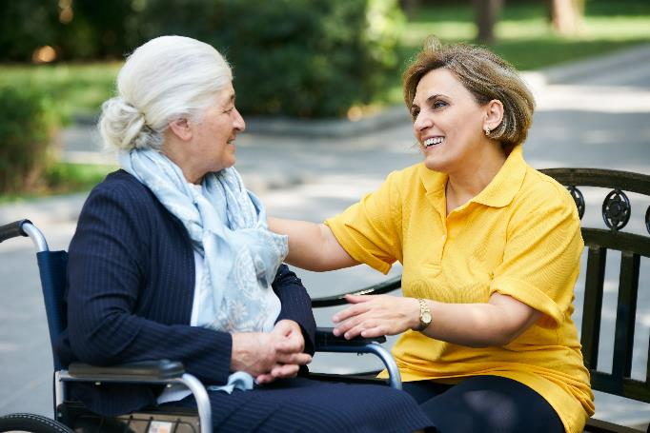
7 of 10 seniors never have a visitor.
How can I make good conversation?
Speak clearly and enunciate.
Lower the pitch of your voice if your Friend is hard of hearing.
Speak a bit more slowly – try not to speak too fast.
Be patient and listen when your Friend answers a question you asked.
Remember to have fun getting to know your Friend and their story!
Notes:
Understand the power of your personal emotional state on the resident.
Your Friend may have physical limitations not limited to sight, vision, endurance and tolerance to fluctuations in temperature.
When having a conversation with your Friend:
Speak clearly and enunciate.
Lower the pitch of your voice if your Friend is hard of hearing.
Avoid speaking too fast.
When you ask a question be patient as they reply.
Have fun getting to know your Friend and their story.

Slide 6
7 of 10 seniors never have a visitor.
What should I say?
Scenario
Your Friend is a memory-impaired resident. Because you were on vacation last week, you have not seen or spoken to them for a while.
Question
When you return for your first visit with your Friend, what should you say?
“Hello Friend, what have you been doing while I’ve been on vacation?”
“Do you remember who I am?”
“Hello Friend, I’m [your name], and I’ve missed visiting you! I was on vacation, so I have been away for two weeks.”
Notes:
Here is an example of what to do when visiting a resident that might have memory issues.
Your Friend is a memory-impaired resident. Because you were on vacation last week, you have not seen or spoken to them for a while.
When you return for your first visit with your Friend; what should you say?
“Hello Friend, what have you been doing while I’ve been on vacation?”
Do you remember who I am?”
“Hello Friend, (I am state your name), and I’ve missed visiting you! I was on vacation, so I have been away for two weeks.”

Slide 7
7 of 10 seniors never have a visitor.
What should I say? (Answer)
Scenario
Your Friend is a memory-impaired resident. Because you were on vacation last week, you have not seen or spoken to them for a while.
Question
When you return for your first visit with your Friend, what should you say?
“Hello Friend, what have you been doing while I’ve been on vacation?”
“Do you remember who I am?”
“Hello Friend, I’m [your name], and I’ve missed visiting you! I was on vacation, so I have been away for two weeks.”
Notes:
Here is an example of what to do when visiting a resident that might have memory issues.
Your Friend is a memory-impaired resident. Because you were on vacation last week, you have not seen or spoken to them for a while.
When you return for your first visit with your Friend; what should you say?
“Hello Friend, what have you been doing while I’ve been on vacation?”
Do you remember who I am?”
“Hello Friend, (I am state your name), and I’ve missed visiting you! I was on vacation, so I have been away for two weeks.”

Slide 8
7 of 10 seniors never have a visitor.
Why is Option C the correct answer?
Hello Friend, I’m [your name], and I’ve missed visiting you! I was on vacation, so I have been away for two weeks.”
This greeting begins by giving informational statements, which reintroduce you to the resident and begin the process of conversation. Tip: Bring some vacation pictures or souvenirs to start the conversation. Ask short questions to see if they remember vacations that they have taken in the past.
For a memory-impaired person, not being able to remember is a painful experience. That’s why you should avoid asking open-ended questions, such as options A and B. These questions make the memory problem obvious, but they do not help bridge it. These questions may be painful for your Friend because they aren’t sure how to answer them.
Notes:
Correct! The Answer is C!
“Hello Friend, (I am state your name), and I’ve missed visiting you! I was on vacation, so I have been away for two weeks.”
For a memory-impaired person, not being able to remember is a painful experience. It is important, therefore, to avoid asking open-ended questions, such as A and B. These questions only point out the person’s memory problem, but they do not help bridge it. These questions may be painful for the residents since they are not sure what to answer.
The best answer is C. It starts by giving informational statements. These remarks re-introduce you to the resident and begin the process of conversation. You might bring some pictures or souvenirs from your vacation and start talking with the residents about them. Ask short questions to see if they remember vacations that they have taken in the past.

Slide 9
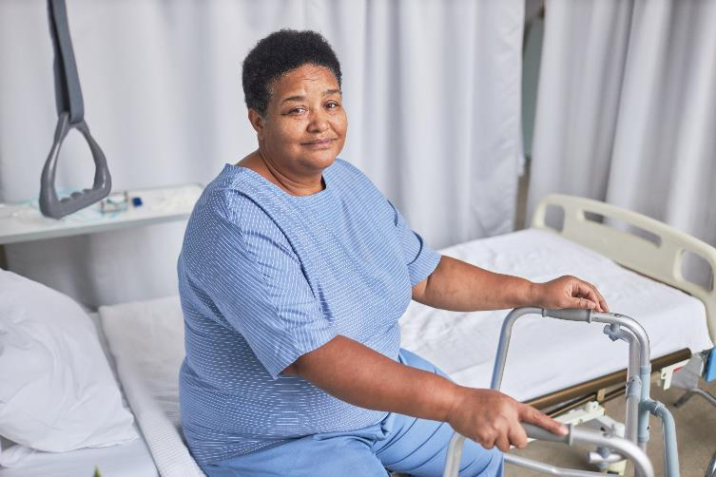
7 of 10 seniors never have a visitor.
How can I continue to be sensitive?
Ask yourself: “What does it feel like to be old?”
Keep in mind that many of the 50,000 elderly persons living in senior care facilities in our area are lonely and in need of companionship.
You are helping us make a difference – thank you!
Notes:
Understand the power of your personal emotional state on the resident.
Your Friend may have physical limitations not limited to sight, vision, endurance and tolerance to fluctuations in temperature.
When having a conversation with your Friend:
Speak clearly and enunciate.
Lower the pitch of your voice if your Friend is hard of hearing.
Avoid speaking too fast.
When you ask a question be patient as they reply.
Have fun getting to know your Friend and their story.

Slide 10
Ending loneliness in the lives of seniors, one senior at a time!
Volunteer Training
Thank you for your time today!
Volunteer Office
Executive Director – Lisa Slavik
Phone 206.406.0839
Lisa.Slavik@friendtofriendamerica.org

Slide 11
Ending loneliness in the lives of seniors, one senior at a time!
Photo Release: Friend to Friend America
PERMISSION TO PHOTOGRAPH
Occasionally, Friend to Friend America program activities may be photographed, videotaped, or audio taped for educational, publicity or fundraising purposes. Please indicate if you give permission to appear in videos, photos or audio recordings without compensation (e.g., as part of brochures, slide shows or program websites).
______ Yes, I give my permission.
______ No, I do not want to appear in a photograph or videotape.
Please email us at volunteer@friendtofriendamerica.org with your preference.

