Slide 1
Ending loneliness in the lives of seniors, one senior at a time!
Volunteer Training
Thank you for being here!

Slide 2
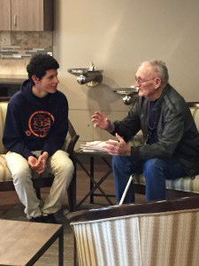
7 of 10 seniors never have a visitor.
7 of 10 seniors never have a visitor.
The need is great.
Far too many of the 50,000 elderly persons living in senior care facilities in our service area are lonely and in need of companionship.
Notes:
Socially-isolated older adults are likely to be sicker and die sooner, and have higher health care expenses, than seniors who retain their social connections. A study by researchers from the AARP Public Policy Institute, Stanford University, and Harvard finds that Medicare spends an estimated $6.7 billion more each year on seniors who have little social contact with others.
…somewhere between 20 percent and 30 percent of older adults report they are lonely, at least some of the time.

Slide 3
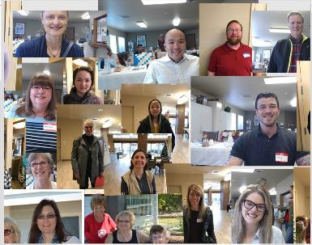
Who are we?
Our vision is to end loneliness in the lives of seniors, one senior at a time, “Friend to Friend”.
Our mission is to recruit and train volunteers in the community to visit lonely and isolated seniors.

Slide 4
Friend to Friend – By the Numbers
40 years supporting Puget Sound residents.
70,000 senior care residents in our service area.
Supporting 150 Volunteer/Senior relationships.
A 501(c)(3) Non-profit organization.
Leaders live & work in the greater Seattle area, matching volunteers in 5 Puget Sound counties: King, Kitsap, Pierce, Snohomish, and Thurston.
2013-2020
814 Volunteer Applications. 564 Requests for Services.
2020-2022
600 Residents supported via Virtual Connections during COVID-19 pandemic.
We want to GROW to meet the increasing needs of our community!

Slide 5
Ending loneliness in the lives of seniors, one senior at a time!
Volunteer Training
Part 1 – Visiting Your Friend

Slide 6
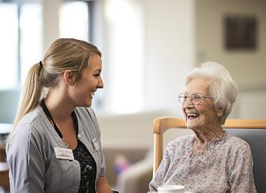
7 of 10 seniors never have a visitor.
What’s my time commitment?
Per Month, at least:
2 visits
2 contact hours
Examples:
Four 30-minute visits
Two 1-hour visits
Work with your Friend to find a schedule & routine that benefit both of you!
Notes:
• The length of the visit isn’t the most important thing.
• That said we would like your Friend to have at least 2 visits a month and 2 contact hours with you, their Friend to Friend, volunteer.
• This can be four 30-minute visits – or any combination to make sure your Friend has that connection at least 2 hours each month.
• You can take your ques from them, their condition, and their attitude. Together you will find a schedule and routine that benefits you both.
• Most importantly enjoy the visit and have fun visiting with your new Friend!

Slide 7
7 of 10 seniors never have a visitor.
How do I set up my first visit?
Check the email you receive after you’re matched – it contains your Friend’s contact information.
Contact your Friend (or their Guardian) to arrange the visit.
You’ll usually schedule visits directly with your Friend, or sometimes, via their Guardian.
The Guardian may ask to be present during your first visit to help with introductions.
Important! When you email your Friend or their Guardian, please include us (volunteer@friendtofriendamerica.org).

Slide 8
7 of 10 seniors never have a visitor.
How do I keep my visit friendly?
Listen! Be non-judgmental & accept attitudes, feelings, and fears.
Let your Friend talk! Sometimes, your Friend just wants to share. You provide emotional support just by being there!
Smile and be cheerful! Avoid talk of unpleasant events like disasters or accidents. Tip: If they’re interested in current events, bring a local newspaper or magazine to read to your Friend – this helps them feel connected to the community.
Be patient! Repetitious old stories serve a purpose. Ask questions about their family members, even if they have passed away. Your Friend can reminisce – and this is a comfort to them.
Avoid controversial topics! This includes politics and religion.
Notes:
Be a listener! A good listener is non-judgmental, accepts attitudes, feelings, and fears.
You give emotional support by your presence sometimes your Friend will just want to share.
Be cheerful and smile. Try to avoid bringing up talk of unpleasant events such as disasters, accidents, or illnesses. If they are interested in current events bring a local newspaper or magazine to read to your Friend for discussion and to help them feel connected to the community.
Be patient of repetitious old stories. They serve a purpose for your Friend, if only to relive happy memories. You might want to ask questions about members of their families even if they have passed away. This is called reminiscence and it is a comfort to them

Slide 9
What is empathy? Is it the same as sympathy?
Empathy is understanding and seeing things through someone else's eyes.
You step into the other person’s shoes and connect with them on a deeper level.
When you empathize with a person, you think beyond your own reality and imagine yourself in their situation—understanding the experience as if it was your own.
Sympathy is feeling compassion or pity for someone.
With sympathy, you might not fully understand a person's experience, but you recognize their hardship and express your concern.
When you sympathize with someone, you say, “I feel sorry for you.”
Treat your Friend as an equal, the way you would treat a friend, by having EMPATHY, not pity. Your care and concern will help your Friend cope.
Notes:
Empathy involves listening actively, understanding another person, and being open and nonjudgmental.

Slide 10
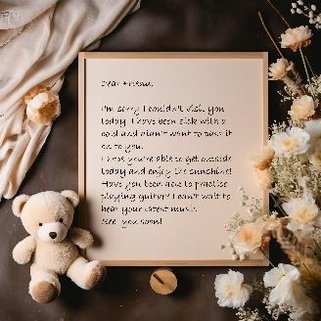
7 of 10 seniors never have a visitor.
How do I keep everyone healthy?
DO NOT VISIT YOUR FRIEND IF YOU:
are Sick
have a fever
have had a fever within the last 48 hours
have had stomach flu or diarrhea within the last 48 hours
feel like you’re coming down with something
plan to bring children who are sick as described above
Send a cheerful note instead!
Notes:
# 1 Please…do not visit when sick:
Please do not visit if you are sick.
Please do not visit if you have or have had a fever – within 48 hours.
You must be fever free for a minimum of 48 hours before visiting.
Please do not visit if you have had a stomach flu or diarrhea-
Make sure you are symptom free for 48 hours before visiting.
Please do not visit if you feel like you are coming down with something.
Please do not bring along children if they have been sick following the rules above.
Please send a cheerful note instead.

Slide 11
7 of 10 seniors never have a visitor.
What if I can’t visit?
Be faithful and prompt. When you say you’ll arrive on a certain day and time, arrive on time!
But if you can’t make it to a visit:
Call your Friend to let them know that you can’t visit this time.
Your Friend may be disappointed, but they’ll understand if you explain ahead of time.
If you can no longer visit your Friend:
Contact the office as soon as possible.
We’ll work together with you to determine the best way to let your friend know and find a replacement for you.
Notes:
If you say you are going to arrive on a certain day and at a certain time, please be faithful and prompt. Disappointment is easily felt, however understood if you call ahead to explain that you cannot come. A phone call may be a great substitute if this situation arises.
If you find you can no longer visit your Friend, please contact the office as soon as possible and we can work together to determine the best way to let your friend know and find a replacement for you.
Treat your Friend as an equal, the way you would treat a friend, by having empathy, not pity. Your care and concern will help your Friend cope.

Slide 12
7 of 10 seniors never have a visitor.
What if things don’t go according to plan?
Important! Any negative feelings expressed by your Friend are not directed at you personally.
If your Friend becomes agitated, abusive, or hostile:
Exit the area.
Contact a staff member.
If this continues, we will work on reassigning you, if necessary.
Keep in mind that anyone can have a bad day, but you are not to be the victim of abuse!
Notes:
Some topics of conversation can elicit strong emotional responses so religious or political discussion and debates should be avoided.
If your Friend becomes agitated, abusive, or hostile, exit the area and contact a staff member. The negative feelings expressed are not directed at you personally, but you must notify staff and if it continues, we will work on reassigning you if necessary.
Understanding everyone can have a bad day, but this said you are not to be the victim of abuse.

Slide 13
7 of 10 seniors never have a visitor.
What if my Friend needs help?
Ring the staff for assistance.
DO NOT lift or assist your Friend physically in or out of a bed or wheelchair.
DO NOT assist with or administer medications.
Notes:
Never Lift or assist your friend physically in or out of a bed or wheelchair.
This must be done by home staff only.
If your friend needs help, please just ring for staff to help.
Never assist with or administer medications, this should be done by facility staff only.
D

Slide 14
7 of 10 seniors never have a visitor.
What if I want to post photos on social media?
You need permission first!
A photo release must be signed by your Friend, their Guardian, or DPOA.
After you obtain permission, please include Friend to Friend America in your post.
Notes:
Do not post photos of you and your senior on social media or share with others unless you have been told that the photo release has been signed by the resident, guardian or DPOA.
If you would like to and you have permission to take and post a photo, please make sure to include Friend to Friend America in your post.
D

Slide 15
7 of 10 seniors never have a visitor.
What if my Friend offers me something?
You must never accept:
Money
Payment of any kind
Gifts of personal items
If your Friend insists, send an email with the details to the Guardian and to us at volunteer@friendtofriendamerica.org.
Why not?
Your Friend may forget they gave it to you and think it’s stolen.
The item may be of sentimental value to your Friend’s family.
Notes:
Do not accept money or payment of any kind from your Friend.
Do not accept gifts of personal items from your Friend.
Your Friend may forget they have given it to you and think it stolen.
The item may be of sentimental value to the family.
Email the guardian if appropriate and volunteer@friendtofriendamerica.org with the details if your Friend is insistent.

Slide 16
7 of 10 seniors never have a visitor.
What if I want to take my Friend on a car ride?
Your vehicle must be in good repair and properly insured. (Your legal liability is no different than if you drive a neighbor somewhere.)
You need permission first! You must obtain permission in advance, in writing, from your Friend’s Guardian.
After you obtain permission, before you go, let the staff know your excursion timeline so they don’t worry and know when to expect your return.
You’re not a chauffer, so don’t feel obligated to drive your Friend anywhere!
Notes:
You are not a chauffeur…that said….
Cars - Going out in your private car:
If you want to take your friend for a ride in your car you must gain permission in writing from the guardian prior to the adventure.
Once obtaining permission let the staff of the community where the senior lives know your timeline so they do not worry and know when to expect your return.
Your legal liability for taking your friend out in the car is no different than if you drive a neighbor somewhere.
Your vehicle must be in good repair and properly insured before you offer to take your friend on a drive.
This said do not feel obligated to drive them anywhere. This is not a function of your volunteering.

Slide 17
7 of 10 seniors never have a visitor.
How do I set up my next visit?
You’re taking time out of your busy schedule to visit your Friend – and that’s much appreciated! But be careful what you say when you plan your next visit.
Why? What if you were trying to schedule lunch with someone and they said:
“I have somewhere important I have to be.” …or…
“I’m so busy – let me look at my schedule and get back to you.”
You’d probably feel unimportant! If you make statements like this to your Friend, they may feel the same way. Instead, identify potential time slots in advance!
Notes:
Finding time for your next visit…
We appreciate that you are taking time out of your busy schedule to become a friendly visitor but want to caution you to avoid using certain phrases that can make your friend feel unimportant or a nuisance….
I have somewhere important I have to be…
I’m so busy, let me look at my schedule and get back to you...

